Slide 1

2022 Uttar Pradesh Legislative Assembly Election
Result Prediction
(Mini Project)
Submitted By -
Prashant Dwivedi
1804610082
Under the Guidance of -
Mr. Abhishek Singh
Sengar
(Asst. Prof.)

Slide 2
Content
Introduction
Problem Statement
Dataset Preparation
Dataset
Sentiment Analysis
Sentiment Polarity on all three Candidates
Result

Slide 3
Introduction
Legislative Assembly elections will be held in Uttar Pradesh in month of February to March 2022 to elect 403 members of the Uttar Pradesh Legislative Assembly.
The Three big competitors in this elections are Yogi Adityanath(BJP), Akhilesh Yadav(SP), Mayawati(BSP).

Slide 4
Problem Statement
Predicting Winning Party Name by analysing the sentiments of people for the candidates on social media (websites like twitter, facebook, instagram).

Slide 5
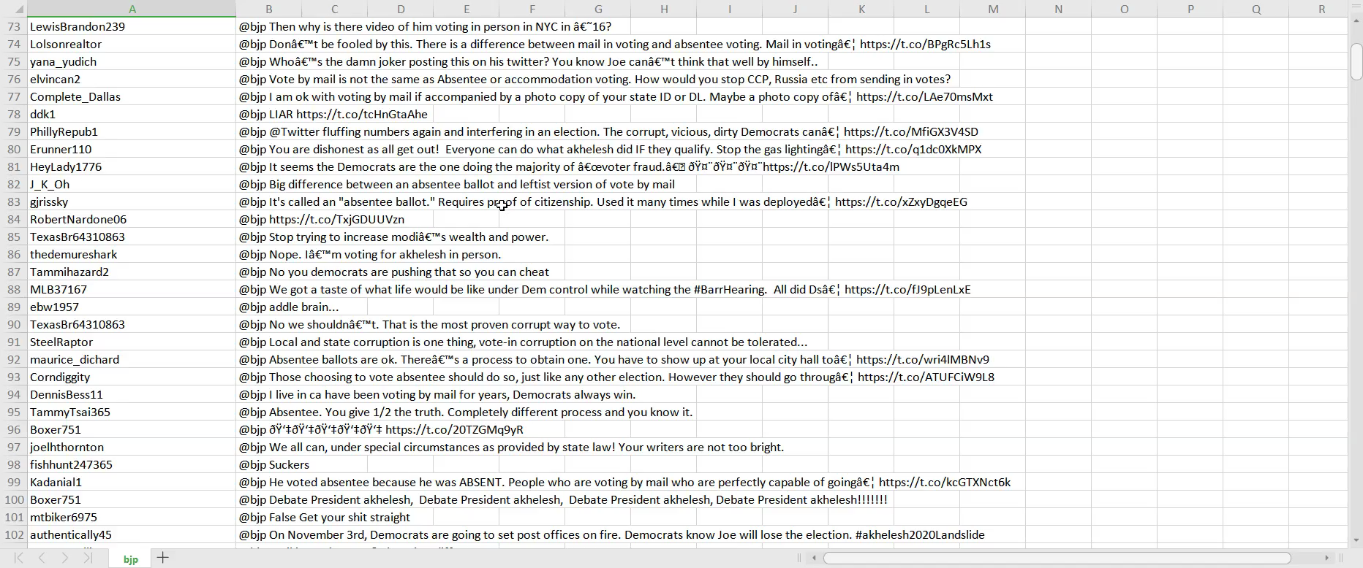
Dataset Preparation
Datasets that are used in this task to predict the UP 2022 Elections are collected from twitter, facebook, instagram by the official twitter handles of Yogi Adityanath(BJP), Akhilesh Yadav(SP), Mayawati(BSP) using python web scraping script.

Slide 6
Dataset
The dataset consists of three files :
+------ data/
| +------ bjp.csv
| +------ bsp.csv
| +------ sp.csv
| | +------ dataset.user : twitter handle
| | +------ dataset.text : tweet
90% of data is prepared from Twitter and rest 10% is prepared from other social media networks (like facebook, instagram).
Around 6000 tweets are stored in the dataset.

Slide 7
Sentiment Analysis
Textblob package in Python is used here for the Sentiment Analysis . Here this package will be used to perform simple text classification in either positive or negative statement on the basis of sentiment analysis .
BJP : Sentiment(polarity=0.6, subjectivity=0.9)
BSP : Sentiment(polarity=0.125, subjectivity=0.16666666666666666)
SP : Sentiment(polarity=-0.15, subjectivity=0.3125)

Slide 8
Sentiment Polarity on all three candidates
New attribute will be added in both the datasets by the name of “Expression Label” and all the tweets with neutral polarity from the datasets will be droped to balance the data equally. Some data cleaning operations are also performed for easy predict the UP 2022 Elections results.
reviews1 = bjp_reviews[bjp_reviews['Sentiment Polarity'] == 0.0000]
cond1=bjp_reviews['Sentiment Polarity'].isin(reviews1['Sentiment Polarity'])
bjp_reviews.drop(bjp_reviews[cond1].index, inplace = True)

Slide 9
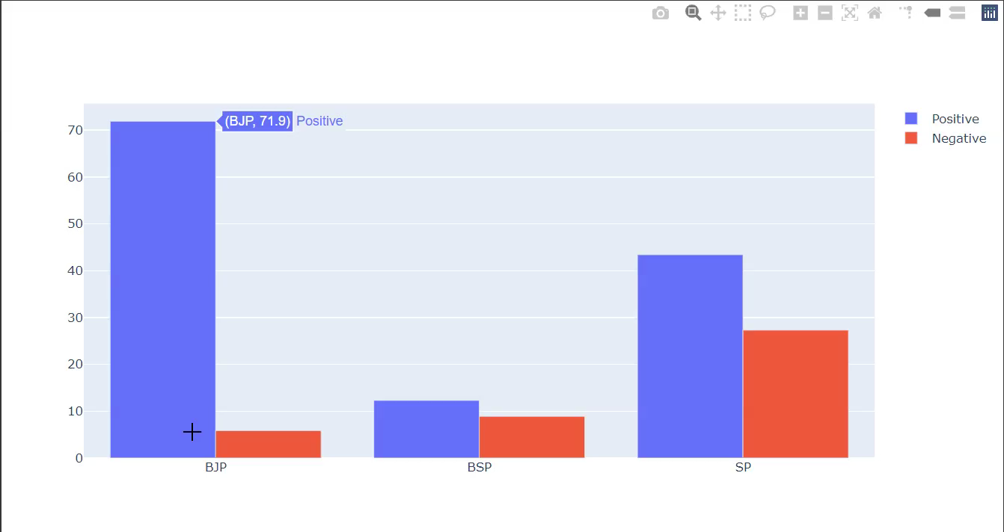
Result
 | Positive Sentiments | Negative Sentiments
BJP | 71.9% | 5.85%
BSP | 12.3% | 8.9%
SP | 43.4% | 27.3%

Slide 10
References
https://www.igi-global.com/dictionary/sentiment-polarity/69751#:~:text=Sentiment%20polarity%20for%20an%20element,about%20the%20entity%20in%20consideration.
https://textblob.readthedocs.io/en/dev/
https://towardsdatascience.com/sentiment-analysis-concept-analysis-and-applications-6c94d6f58c17#:~:text=Sentiment%20analysis%20is%20contextual%20mining,service%20while%20monitoring%20online%20conversations.
https://en.wikipedia.org/wiki/2022_Uttar_Pradesh_Legislative_Assembly_election
https://www.financialexpress.com/india-news/up-elections-bjp-likely-to-retain-state-but-samajwadi-party-may-give-tough-fight-predicts-opinion-poll/2386941/

Slide 11
Thank You

